Slide 1
Alka-Seltzer Reaction at 22.80 ºC

Slide 2
15 seconds
7.10 cm
Move the line up

Slide 3
18 seconds
9.00 cm

Slide 4
21 seconds
10.40 cm

Slide 5
24 seconds
11.45 cm

Slide 6
27 seconds
12.50 cm

Slide 7
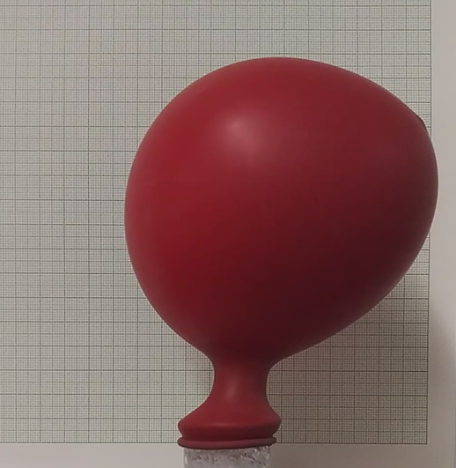
30 seconds
12.65 cm

Slide 8
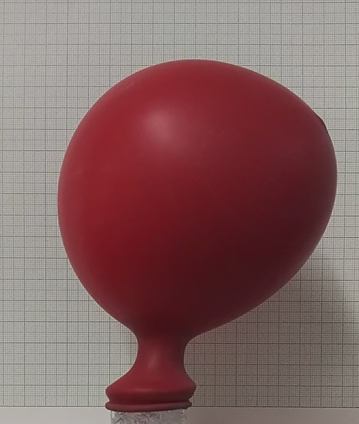
33 seconds
13.00 cm

Slide 9
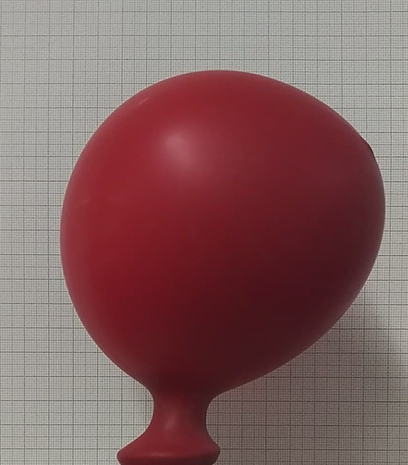
36 seconds
13.30 cm

Slide 10
Alka-Seltzer Reaction at 5.50 ºC

Slide 11
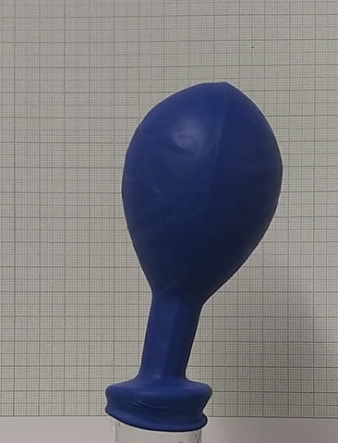
21 seconds

Slide 12
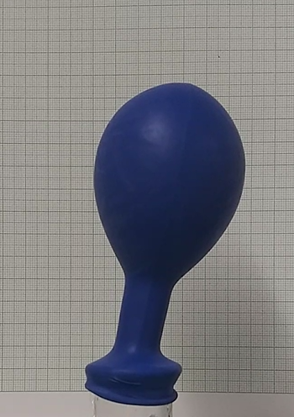
24 seconds

Slide 13
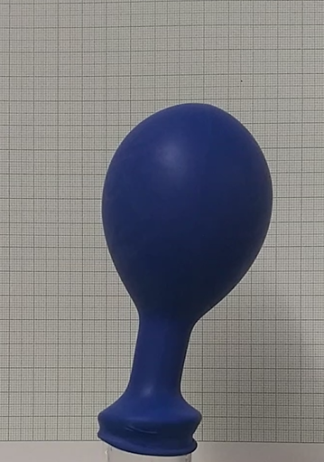
27 seconds

Slide 14
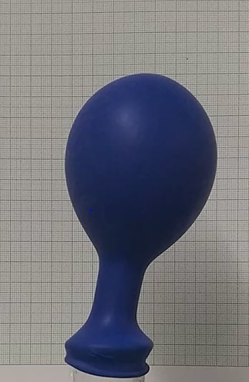
30 seconds

Slide 15
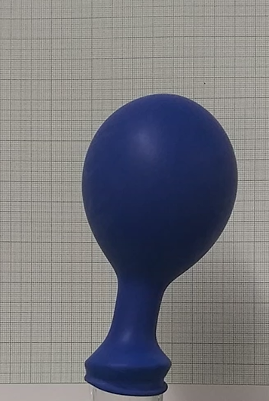
33 seconds

Slide 16
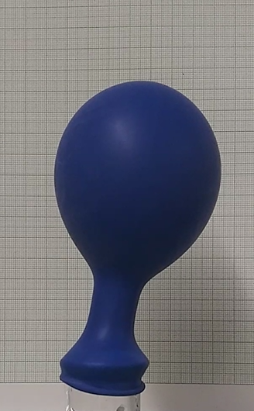
36 seconds

Slide 17
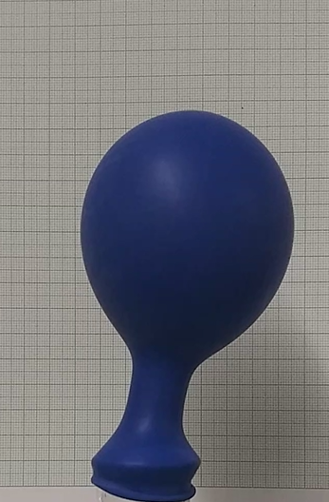
39 seconds

Slide 18
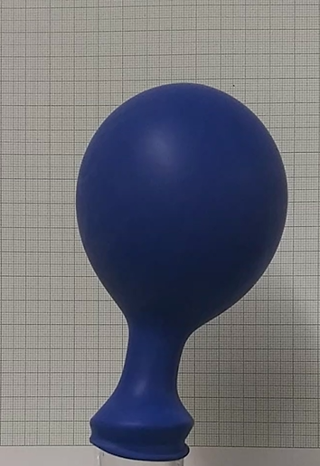
42 seconds

Slide 19
Alka-Seltzer Reaction at 35.50 ºC

Slide 20
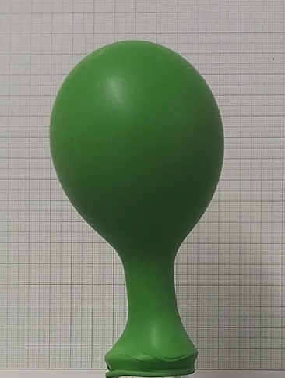
18 seconds

Slide 21
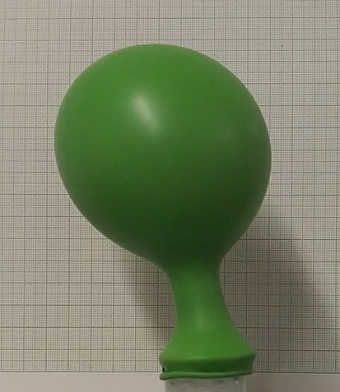
21 seconds

Slide 22
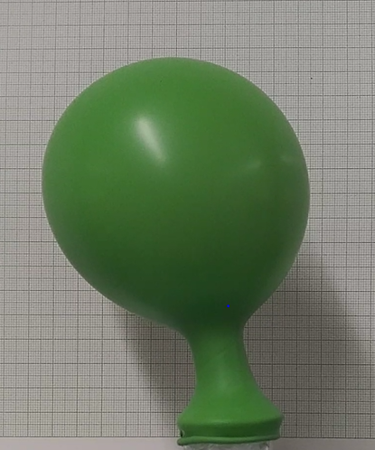
24 seconds

Slide 23
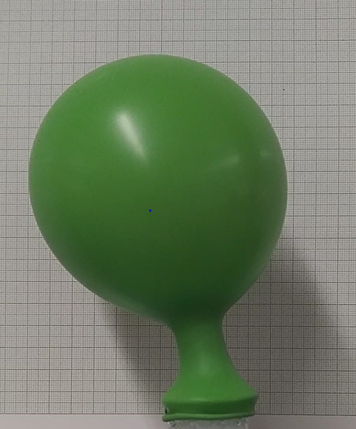
27 seconds

Slide 24
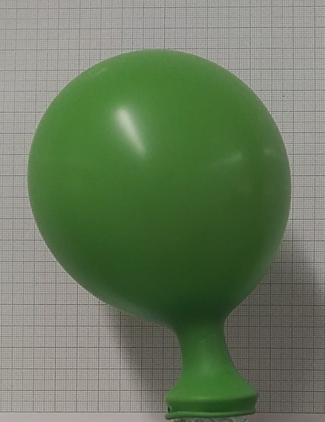
30 seconds

Slide 25
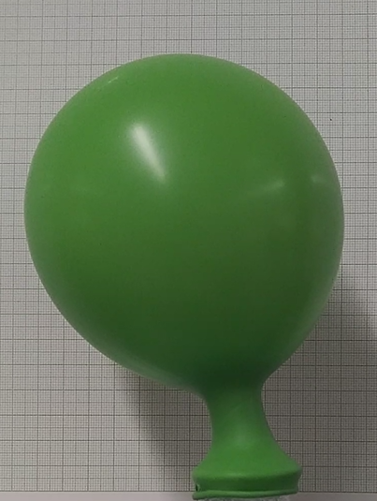
33 seconds

Slide 26
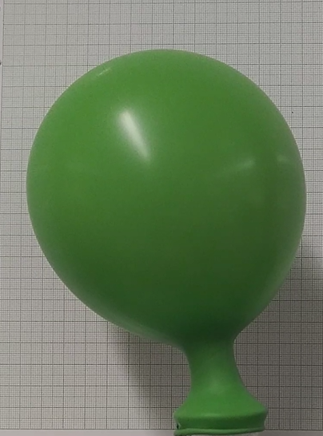
36 seconds

Slide 27
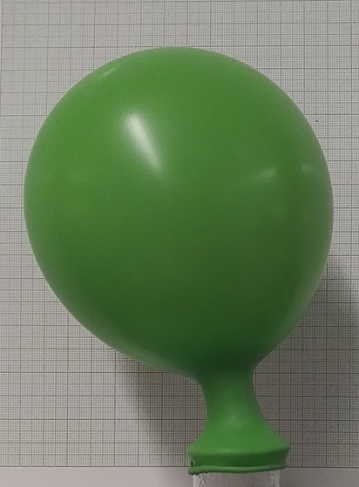
39 seconds

